Slide 1


INTER-IIT 9.0 Problem Statement
JAGUAR LAND ROVER
AUTONOMOUS CHARGER
Team Name : MODIfiers

Slide 2


Overview
Team Introduction
3
Problem Statement
4
Our Approach
5
CAD Model
6-7
Charger Port Detection
8
Environment Model
9
Simulation
10-11
Conclusion
12

Slide 3

Team Introduction
Kanisk Gupta (L)
MATLAB SIMULATION
2.Trinankur Bera
CAD MODELLING
3. Jayjit Mandal
COMPUTER VISION
4. Manab Tikadar
COMPUTER VISION
5. Maharishi Sonwani
CAD & MATLAB SIMULATION

Slide 4
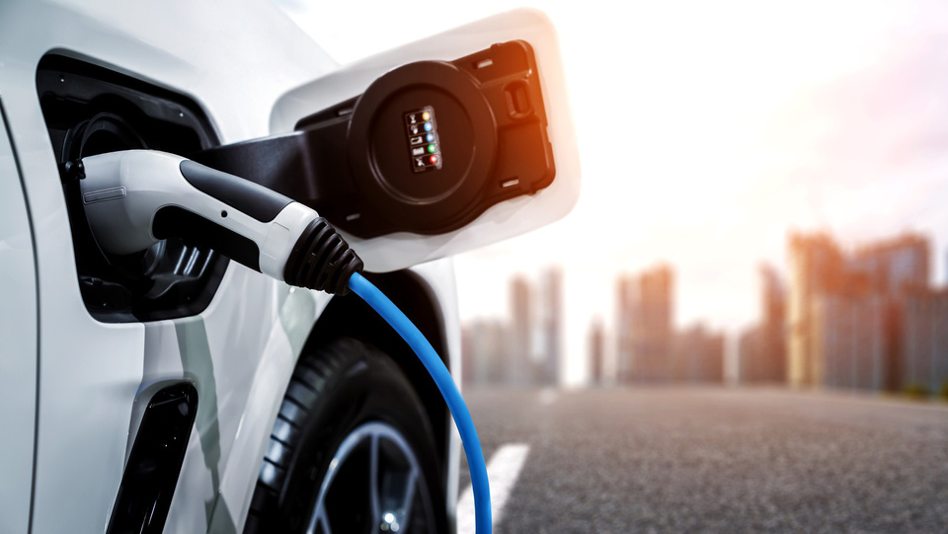
Problem Statement
TASK 1 :
Detect the location of the plug: Use any technology of your choice to accurately detect the position of the plug, which can be deployed on a production vehicle.
Your robot’s charging end should be able to move and latch/unlatch the charging plug into the socket autonomously and return to its location.
TASK 2 :

Slide 5
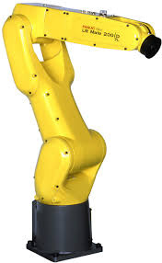
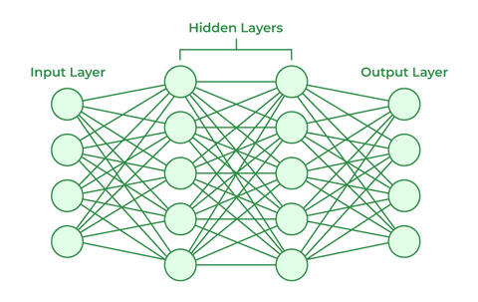
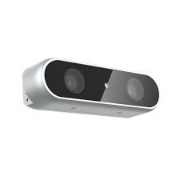
Our Approach
NEURAL NETWORK
MANIPULATOR
CAMERA
CONTROLLER

Slide 6
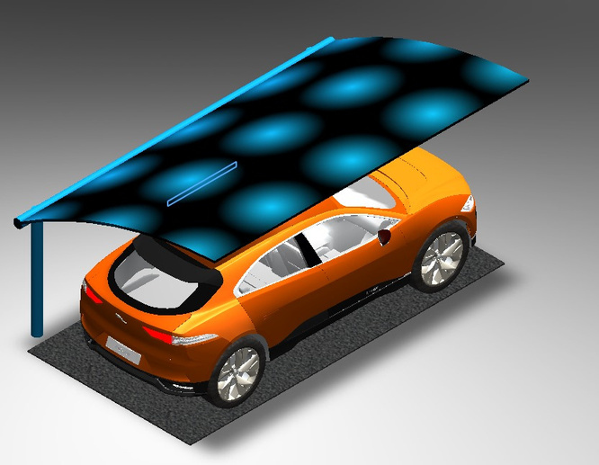
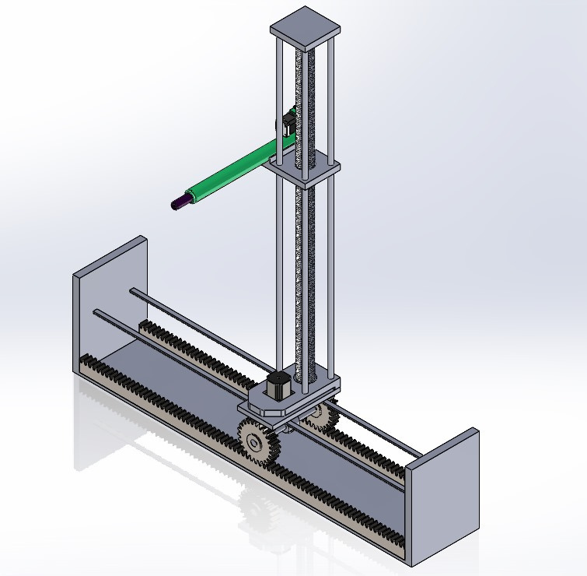
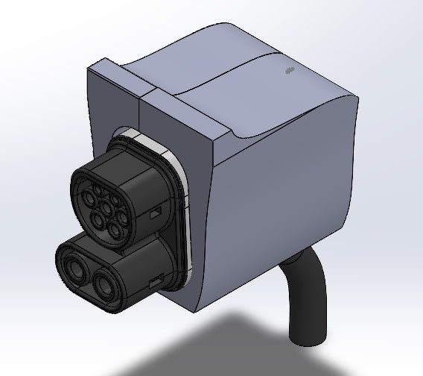
CAD MODEL

Slide 7
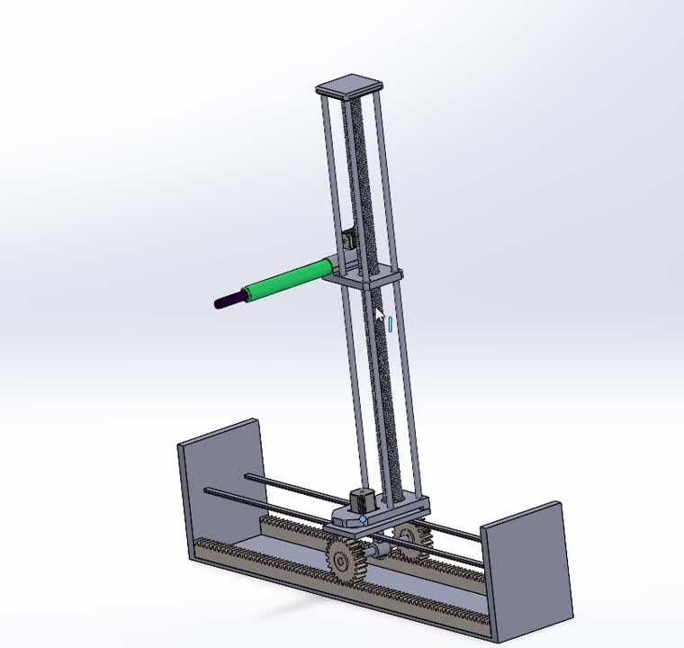
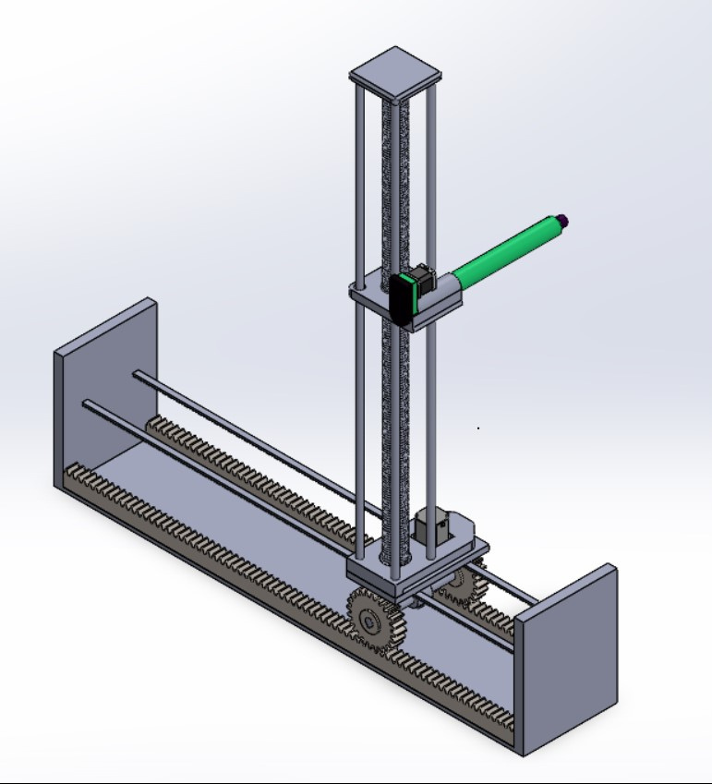
ISOMETRIC VIEW

Slide 8
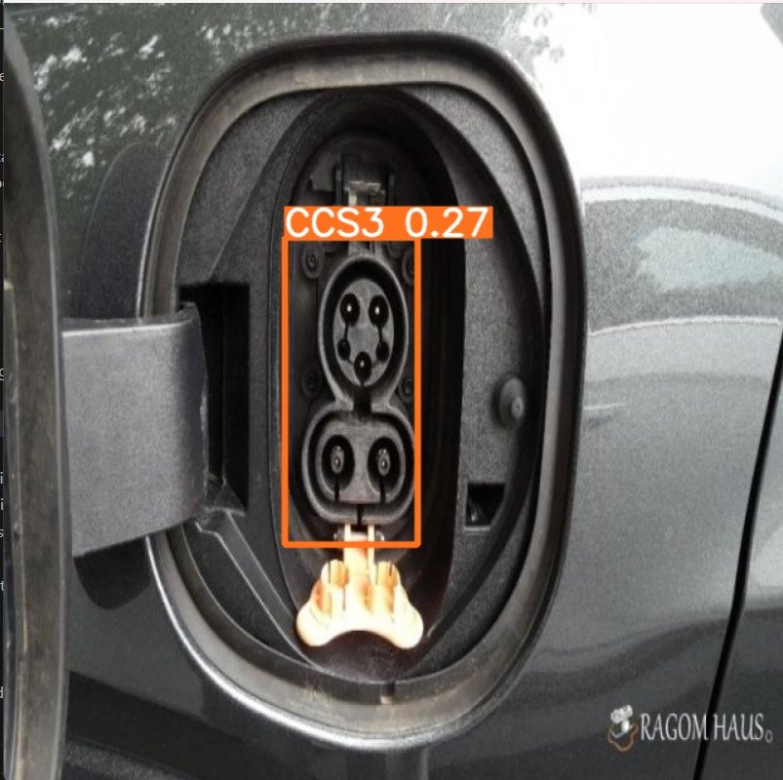
Port Detection

Slide 9
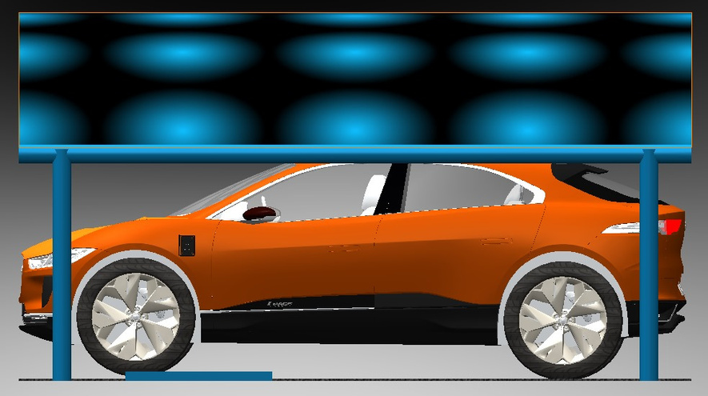
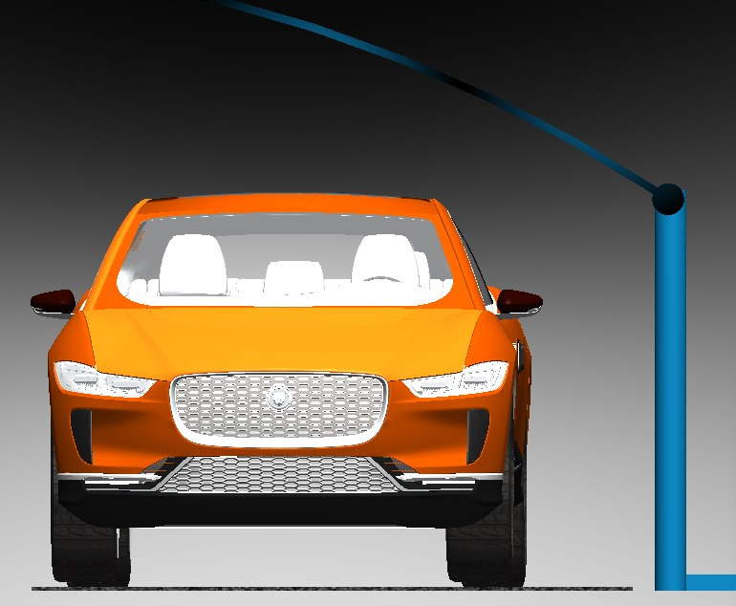
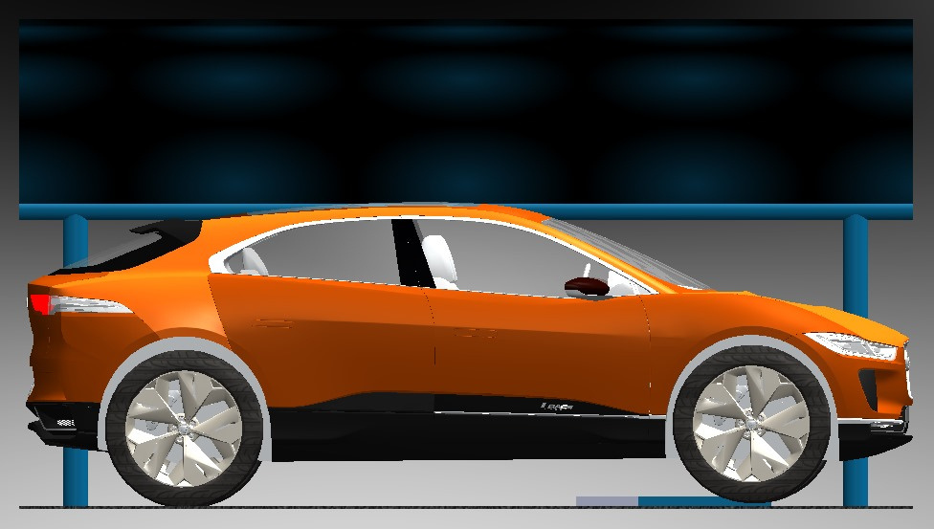
Environmemt Model

Slide 10
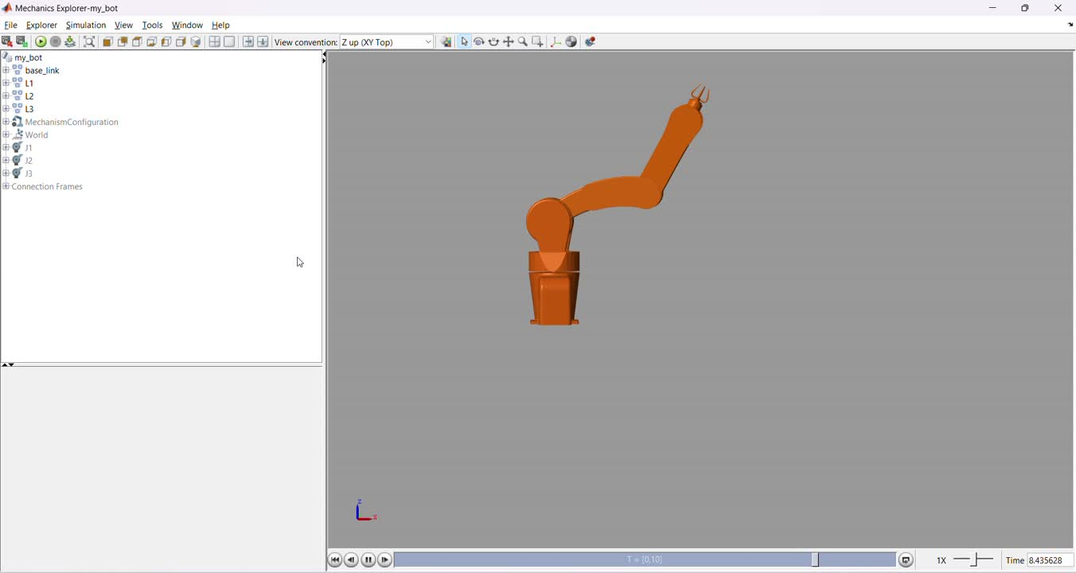
Simulation

Slide 11
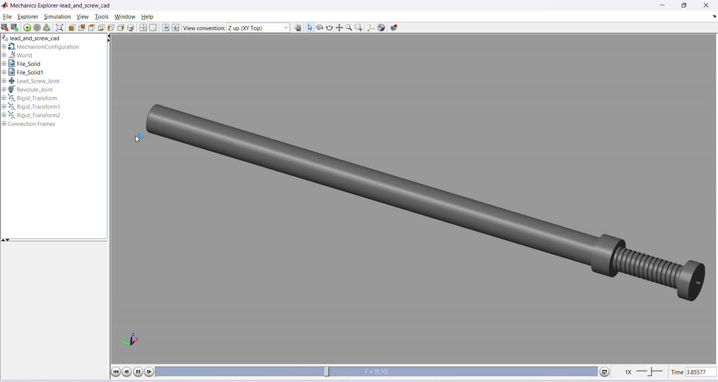
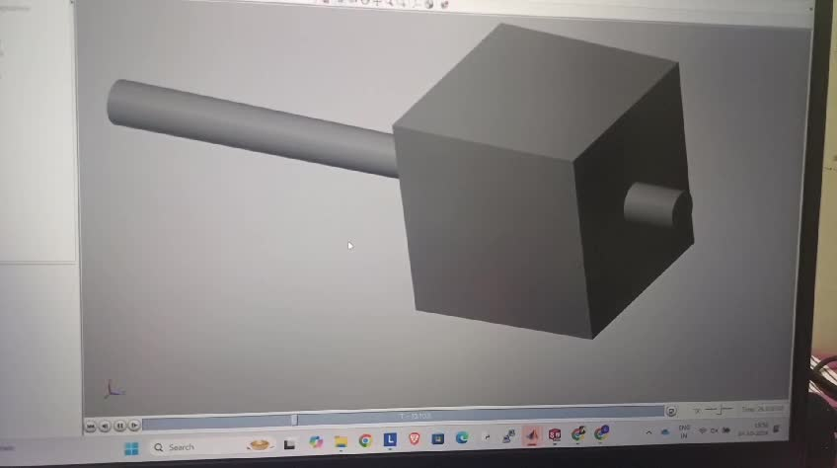
Simulation

Slide 12

THANK YOU!

